Slide 1

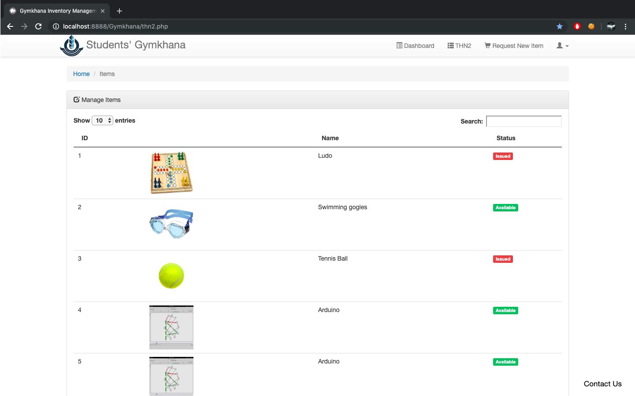
Gims
Gymkhana Inventory Management System
A secure, distributed and multi user access level equipment issue and inventory management system

Slide 2
Outline
Problem Statement and Use Cases
Requirement specifications
Technology Stack
Database Design
Application Implementation
Salient Features
Demo

Slide 3
The Problem
Necessity is the mother of invention.

Slide 4
Problem statement and use cases
Unfortunately, IIT Bhubaneswar lacks a proper system for management of the resources held by the Students’ Gymkhana
We wanted to create a robust, secure and easy to use system that can be used for:
Student access to real time availability of equipment available for issuing
Equipment inventory management at hostel Gymkhana office with real time tracking of available, issued and damaged items
Allow a central administrator to manage accounts of all stakeholders
Allow requests from students for buying new items in future

Slide 5
Requirement Specifications
What do we need?

Slide 6

Data Requirements
Information about all the equipment that the Gymkhana currently owns.
Information about all the students(roll no., name, hostel and email-id) in the institute.
Application Requirements
An apache web server with php and MySQL databases.
Cron job running the mail services.

Slide 7
Technology Stack
The building blocks.

Slide 8
Technology Stack
MySQL
HTML
CSS
PHP
JavaScript
Ajax
jQuery
Python

Slide 9
Database Design
Let your imagination run wild.

Slide 10
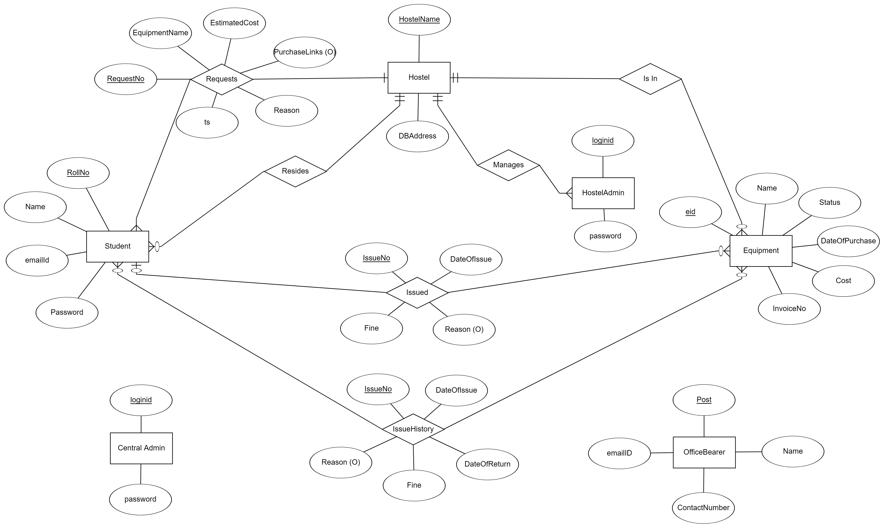
Entity-Relationship Diagram

Slide 11
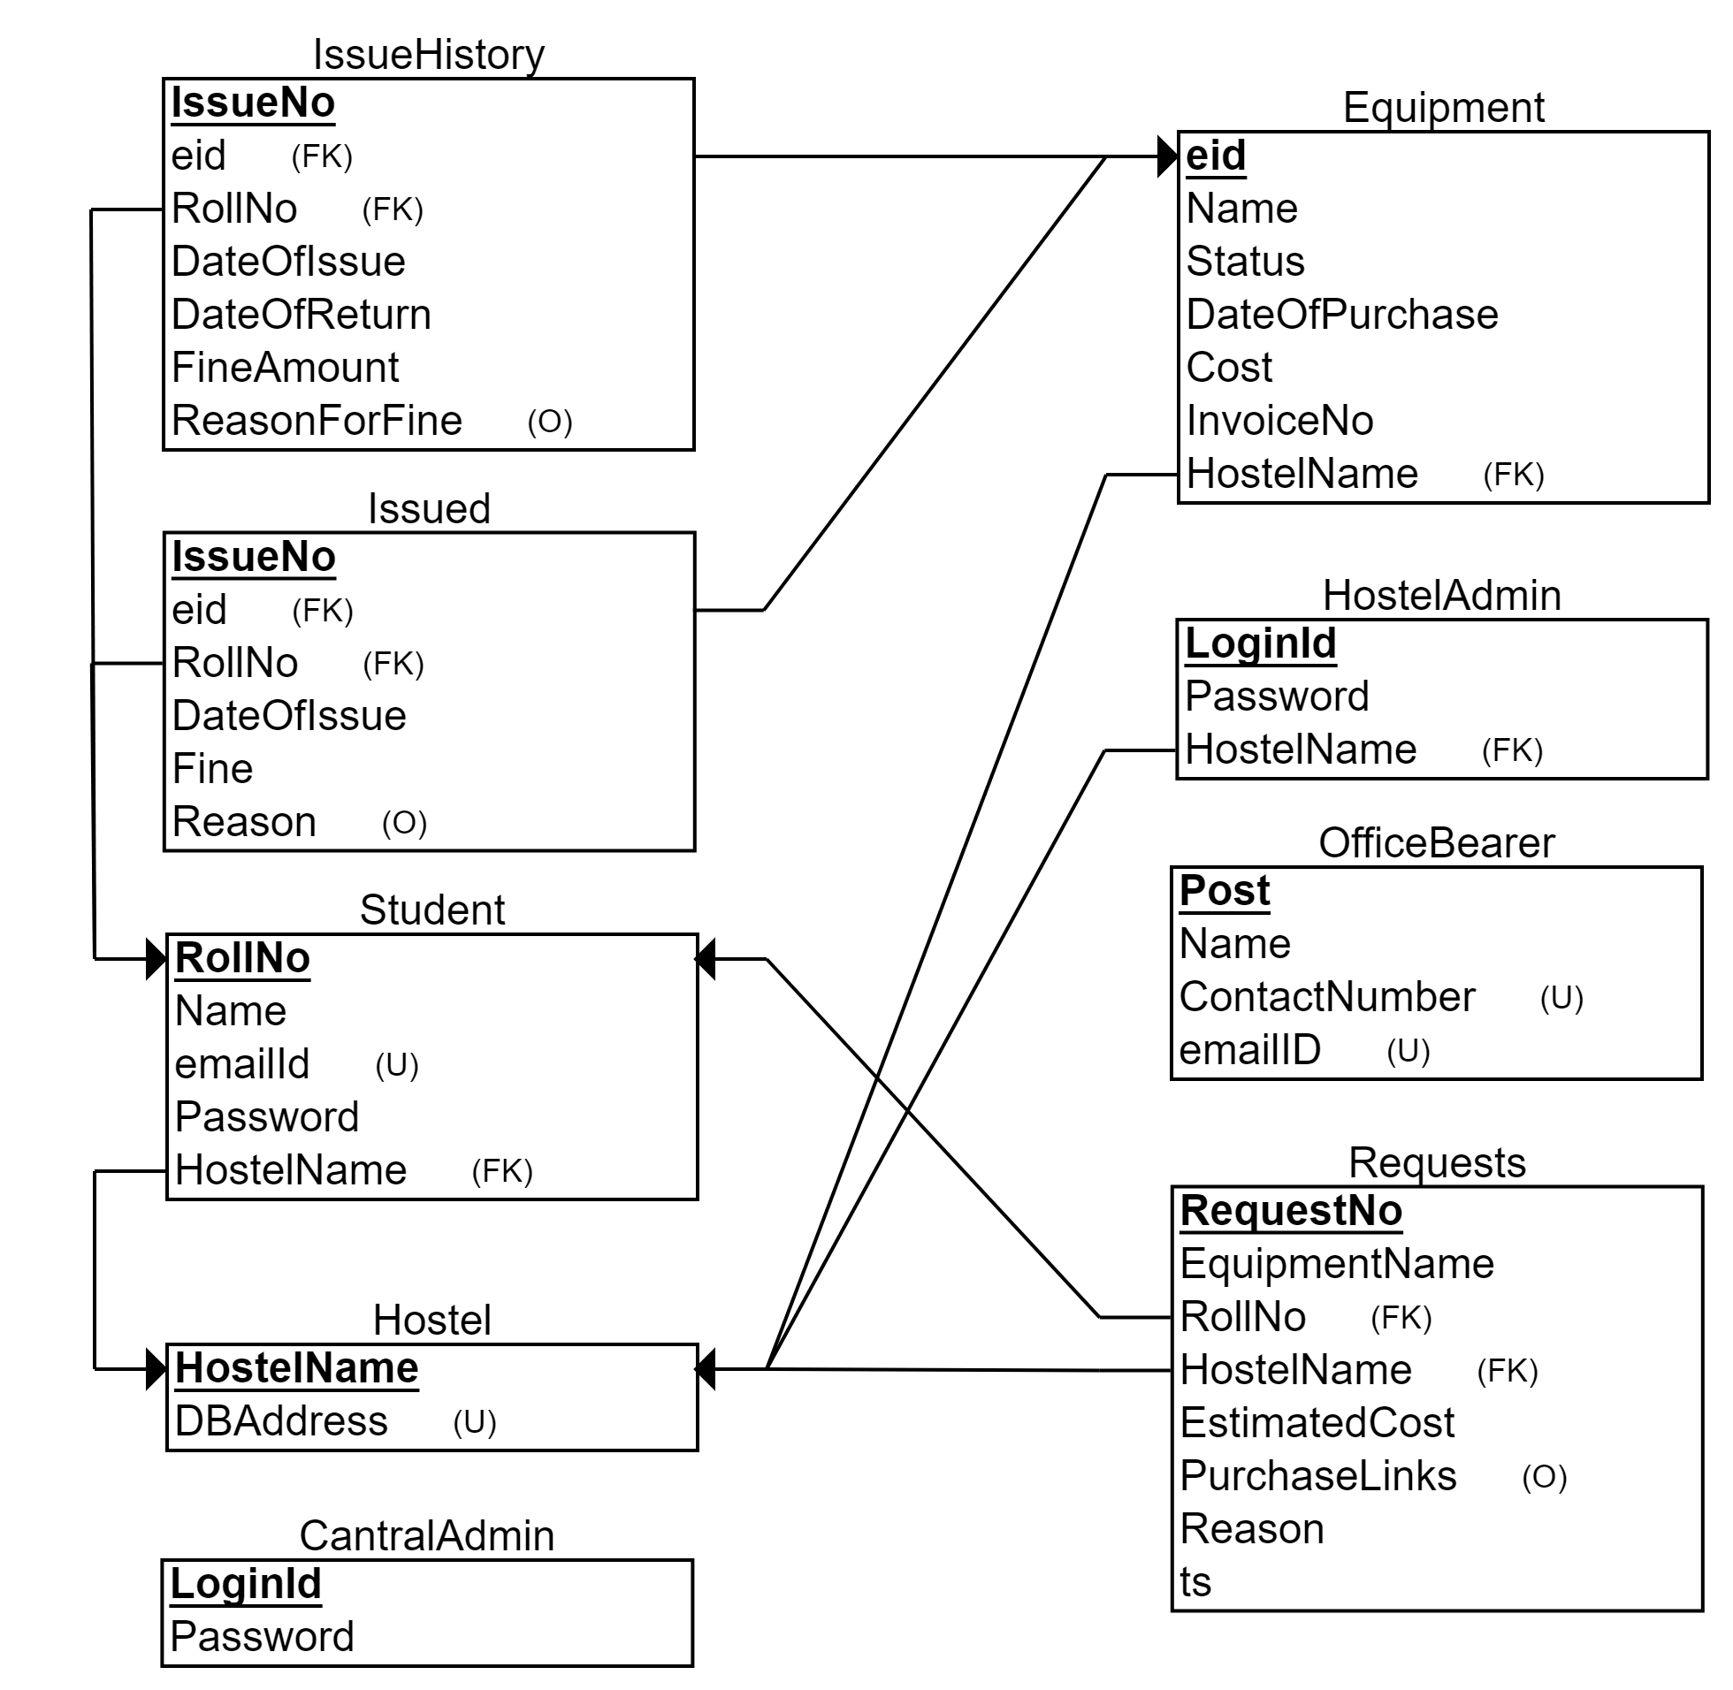
Relational Schema

Slide 12
Application Implementation
Let’s get our hands dirty.

Slide 13
Triggers, Events and Email Services
Triggers:
issue
returned
checkIssue (application level)
passswordChange (application level)
AcceptRequest (application level)
Events:
cal_fine
Email Services:
Issue
Return
Reminder

Slide 14
UI Features
Display currently issued items for students, and hostel admins and hostel details for central admin’s dashboard.
Display list of items with images in the hostel with availability status.
Facility for hostel admin to issue/return and edit an item
Facility for all types of users for changing passwords and changing username for admins.
Facility for central admin to reset password for any user in case he/she forgets it.

Slide 15
UI Features
Facility for central admin to add users be it student or hostel admins.
Running search facility on the basis of any field
Sorting the displayed information.
Facility for a student to request the hostel to buy an item which does not exist, and upon buying the same, request can be accepted or else rejected.
Display details of Gymkhana Office Bearers for quick access to their contact information.

Slide 16
Salient Features
Why choose Gims?

Slide 17
Salient Features
Distributed database for load balancing and optimising performance.
Password hashing using bcrypt algorithm instead of md5 hashing which can be broken into using brute force with advanced computing resources.
An email service for students when an item is issued or returned and reminders when an issued item is soon going to be due.
Request an item feature for students.
Different access levels provide more security and allow only authorised access to data based on privilege level.
Images directly stored to directory and not in database to reduce unnecessary overheads.

Slide 18
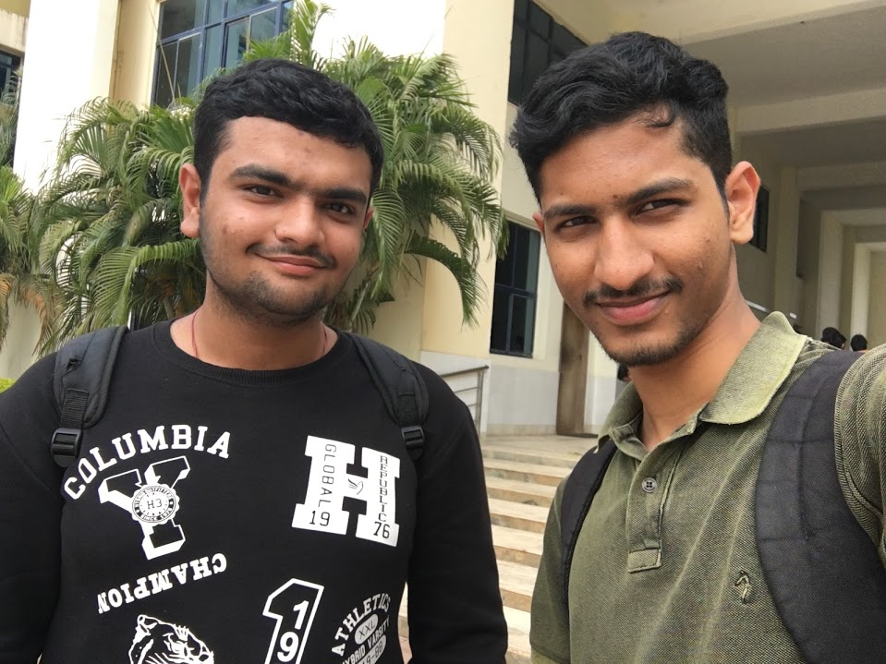
Team Members
Saksham Arneja Tummala Madhav
16CS01042 16CS01041

Slide 19
Demo
It’s show time.

